Slide 1
Sales Dataset Analysis – Advanced Excel Project
Nithish
12.12.2024
Data analytics & Data Science
Oct 2024(regular)

Slide 2
Project Overview To analyze sales data to identify trends, understand sales performance, and provide actionable business insights.
OBJECTIVES
Analyze sales trends over time.
Identify high-performing products and sales channels.
Determine the impact of returns and discounts.
Create a dynamic dashboard with key metrics.

Slide 3
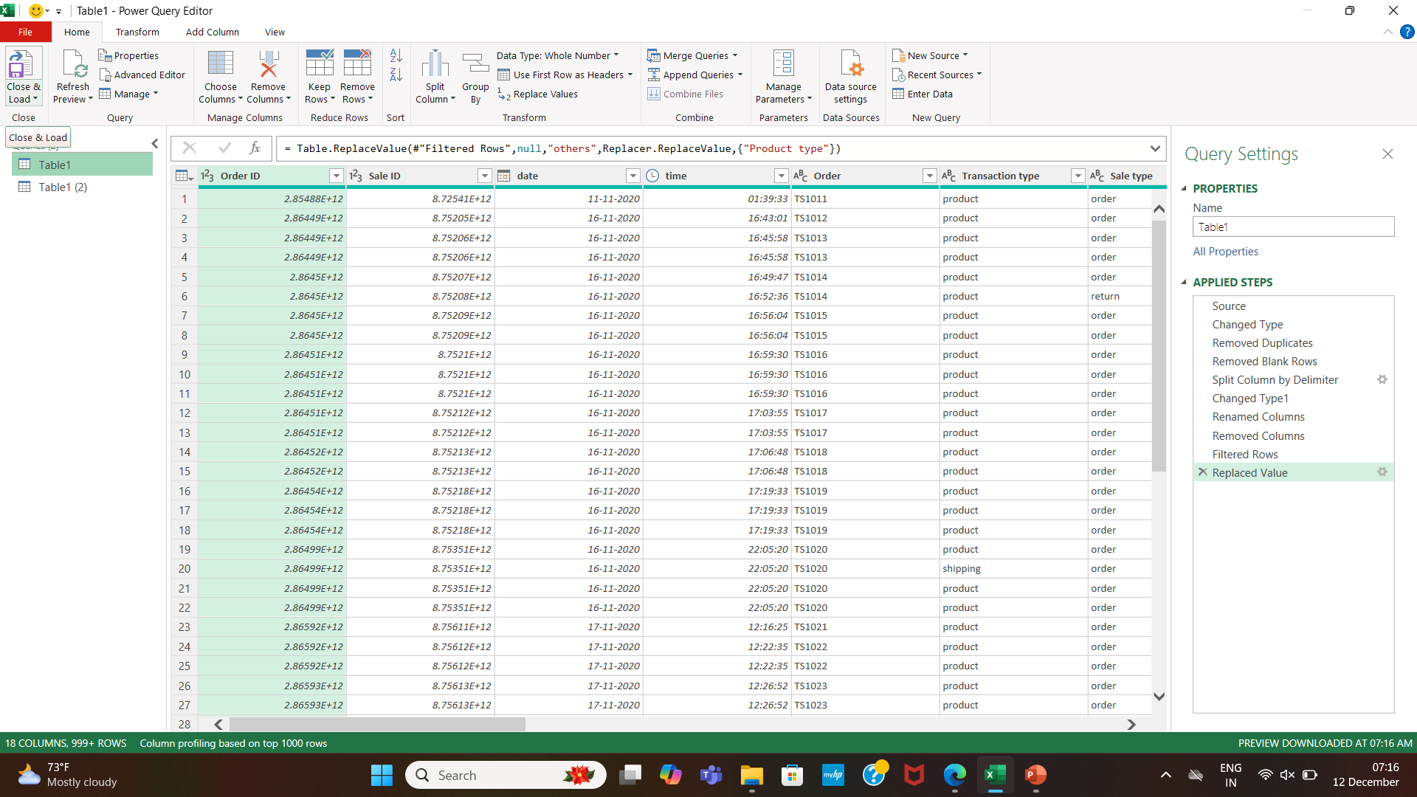
Data Set Overview
Data Cleaning
Removed Blank Rows, Duplicate Rows and Splited colums.
Cleaned Using Power Query

Slide 4
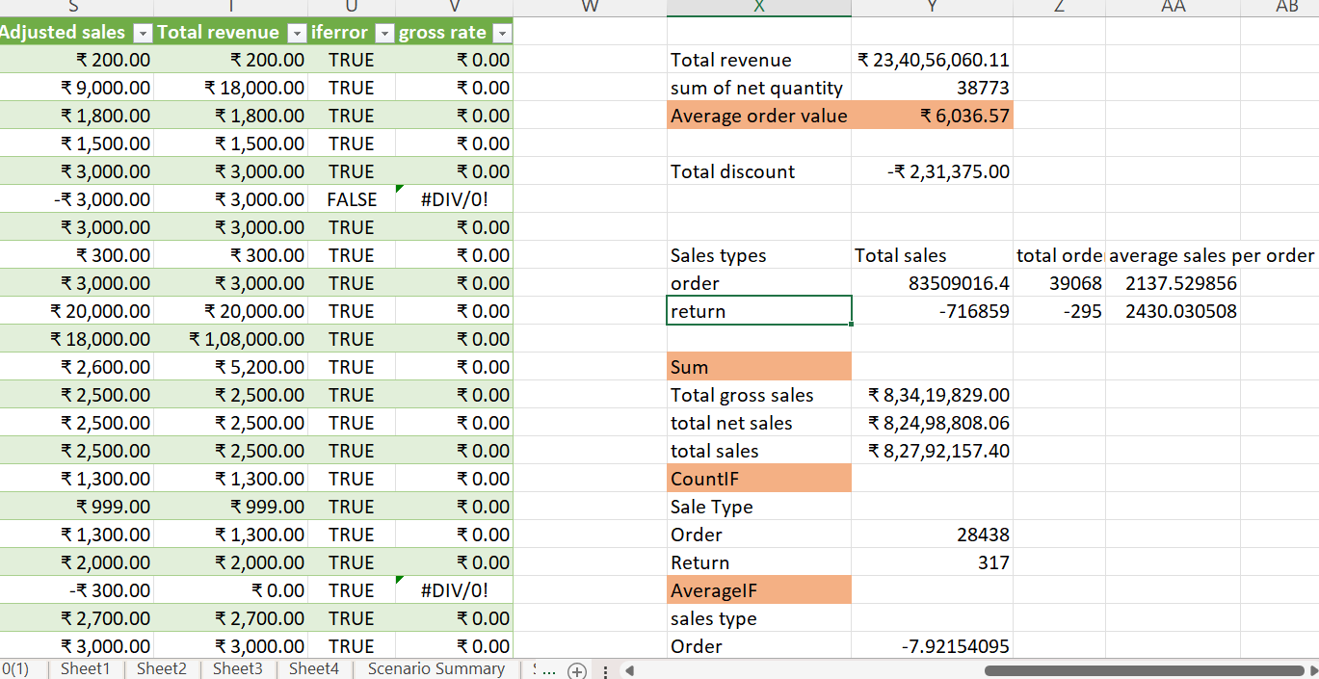
Important Calculations
Total sales (Gross, Net, Adjusted)
Average sales per order
Discount rates, return rates
Sales by channel/product type

Slide 5
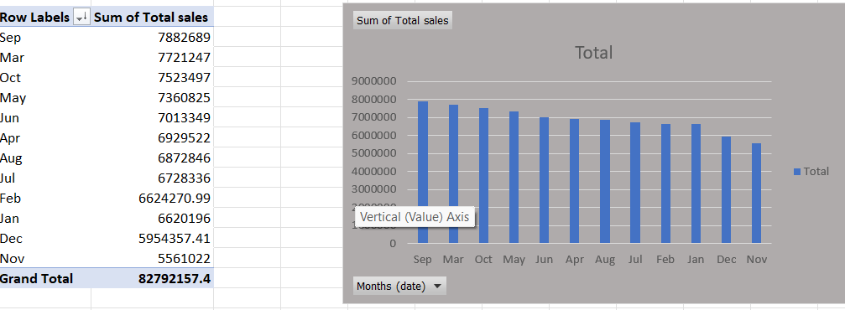
PIVOT TABLE AND CHARTS

Slide 6
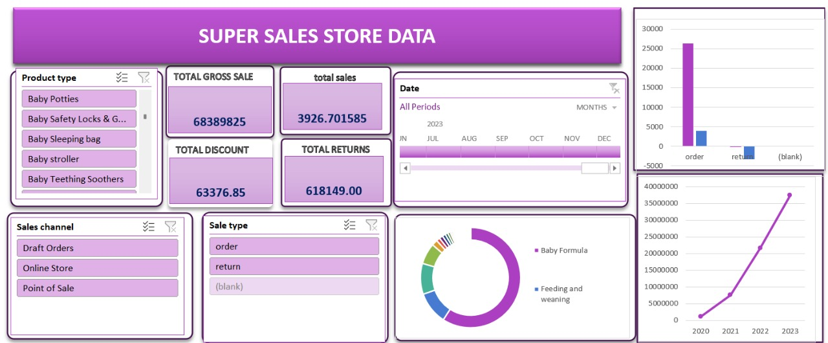
DASBOARD

Slide 7
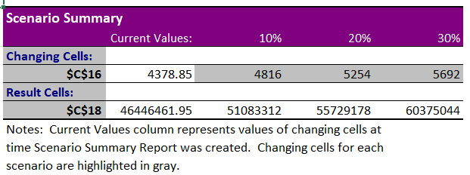
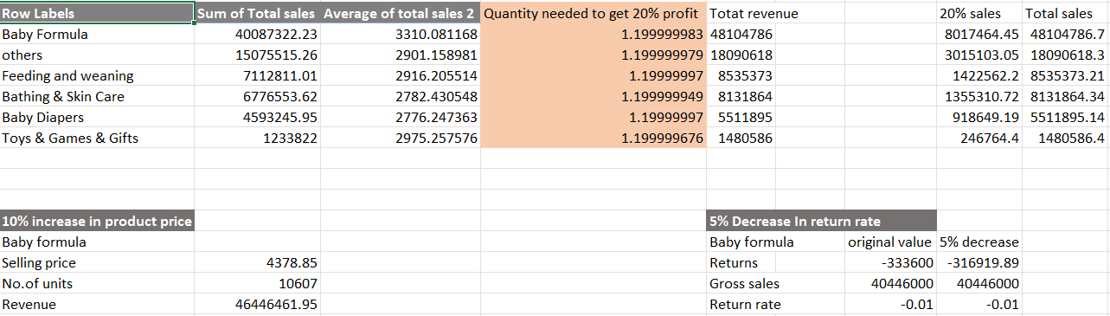
WHAT IF ANALYSIS
GOAL SEEK

Slide 8
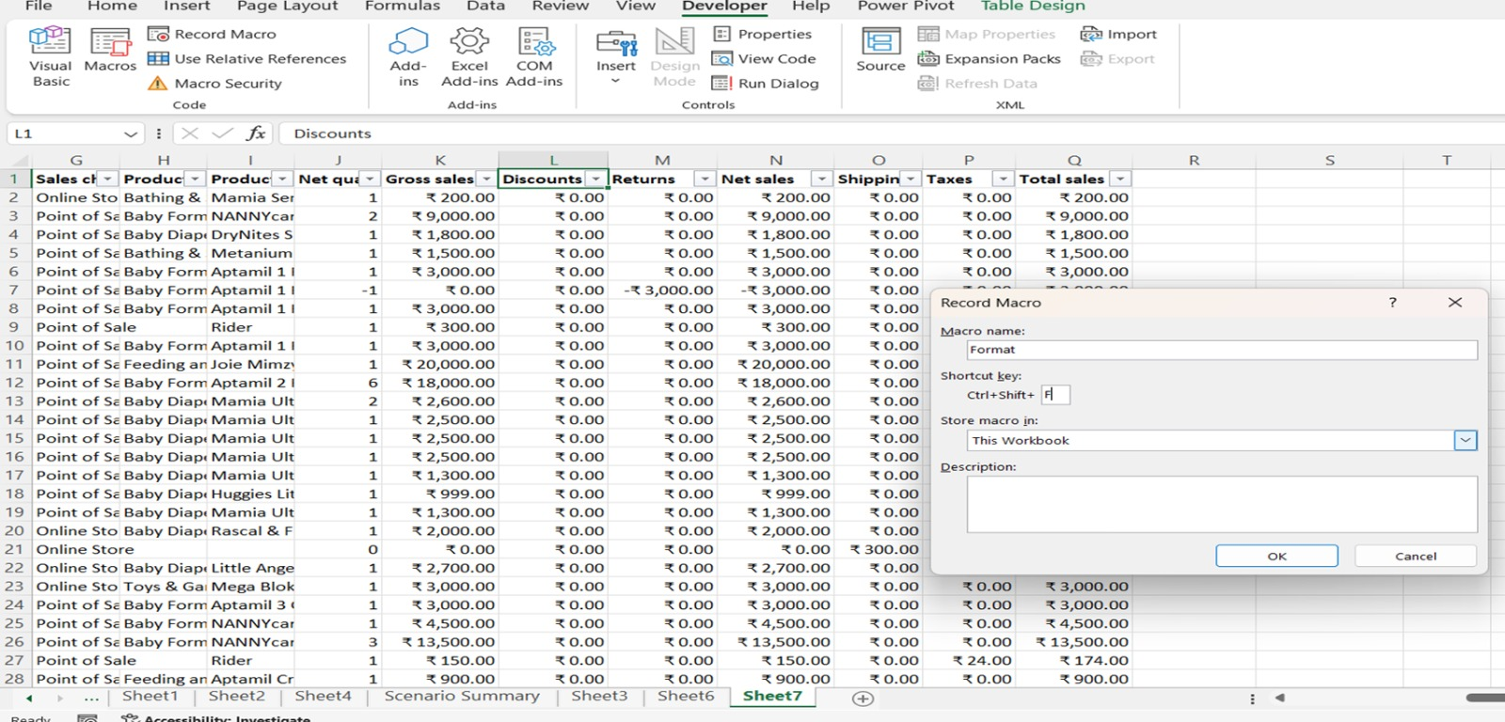
Macros and automation

Slide 9
Insights
Top selling Products are Baby Formula followed by feeding and weaning.
Seasonal Peak is in September
Gradually sales increased year by year.

Slide 10
Conclusion
In this Analysis, BABY FORMULA is sold more compared to other products mainly in September month.
We can focus on the bottles and bottling sets by giving discounts or offers.
In future we should increase the products quality to grab more customers.

Slide 11
THANK
YOU

